Slide 2
Cloud Native Essentials - A 101 Tutorial to Start Your Cloud Native Journey
Rey Lejano, SUSE Eamon Bauman, Red Hat
Notes:
Learning about cloud native projects can be difficult and time consuming on your own. This 90 minute tutorial introduces and demystifies many CNCF graduated projects. In this tutorial we’ll give an overview of CNCF graduated projects, what problems they solved, and how to use them. The tutorial will go through the installation, setup, and use of the following: the container runtime containerd to be used with upstream Kubernetes, the latest version of upstream Kubernetes (including etcd), Harbor for a container registry, Helm to deploy an application, Prometheus for monitoring, fluentd for logging, Open Policy Agent and Gatekeeper for admission control for compliance. After this tutorial, you’ll be well on your way on your cloud native journey.
Every year, the majority of the KubeCon audience are first timers – although this doesn’t mean most are new to cloud native but I’ve met many KubeCon attendees that are. The tutorials in the past have been very technical and implied required experience like eBPF, WASM, observability from the 2023 KubeCon + CloudNativeCon Europe schedule. This tutorial is accessible for folks that are new to cloud native and enables them with a thorough, short, hands-on introduction to many CNCF graduated projects. Cloud VMs will be provided for the in-person audience.

Slide 3




About Us
About us
Rey Lejano
SUSE
Eamon Bauman Red Hat
@eamonb
@reylejano

Slide 4
About Us
Rey Lejano
SUSE
Eamon Bauman Red Hat
@reylejano
@eamonb

Slide 5
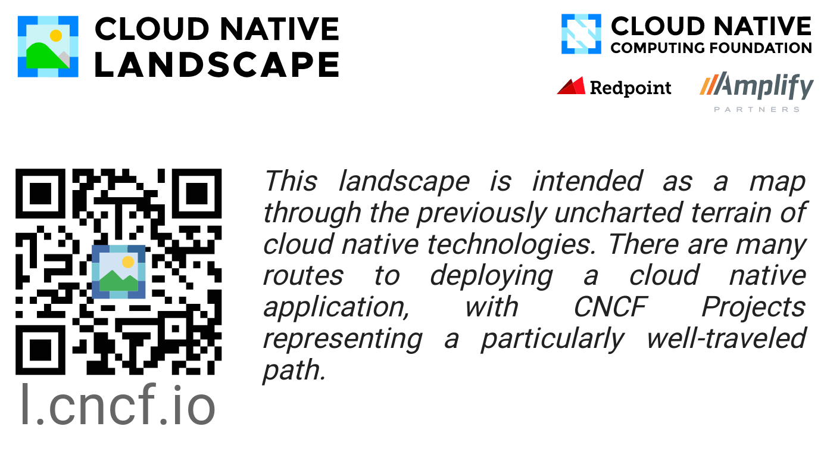
Where do we start?

Slide 6
Where do we start?

Slide 7
Where do we start?

Slide 8
Where do we start?

Slide 9
Where do we start?

Slide 10
Where do we start?

Slide 11
Where do we start?

Slide 12
Where do we start?

Slide 13


Where do we start?
Notes:
Take inspiration from the sextant
A sextant uses two reference points to find latitude reading, measures the angle between a celestial object and horizon
We’ll use two points of reference to help guide us on this cloud native journeyL

Slide 14



CNCF Stages
Notes:
First point of reference well use to help guide us on our cloud native journey
CNCF Graduated projects
Sandbox – early stage projects
Graduated and incubating projects are considered stable and are used successfully in production environments.
Incubating – used in production, healthy number of contributors
Graduation:
Have committers from at least two organizations.
Have completed an independent and third party security audit with results published
Explicitly define a project governance and committer process.
Explicitly define the criteria, process and offboarding or emeritus conditions for project maintainers; or those who may interact with the CNCF on behalf of the project.
Have a public list of project adopters for at least the primary repo
Receive a supermajority vote from the TOC to move to graduation stage. Projects can attempt to move directly from sandbox to graduation, if they can demonstrate sufficient maturity.

Slide 15
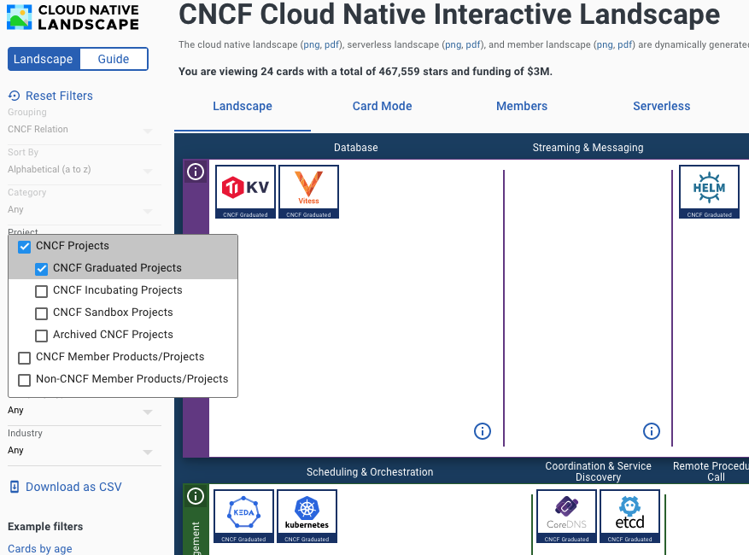
CNCF Stages

Slide 16



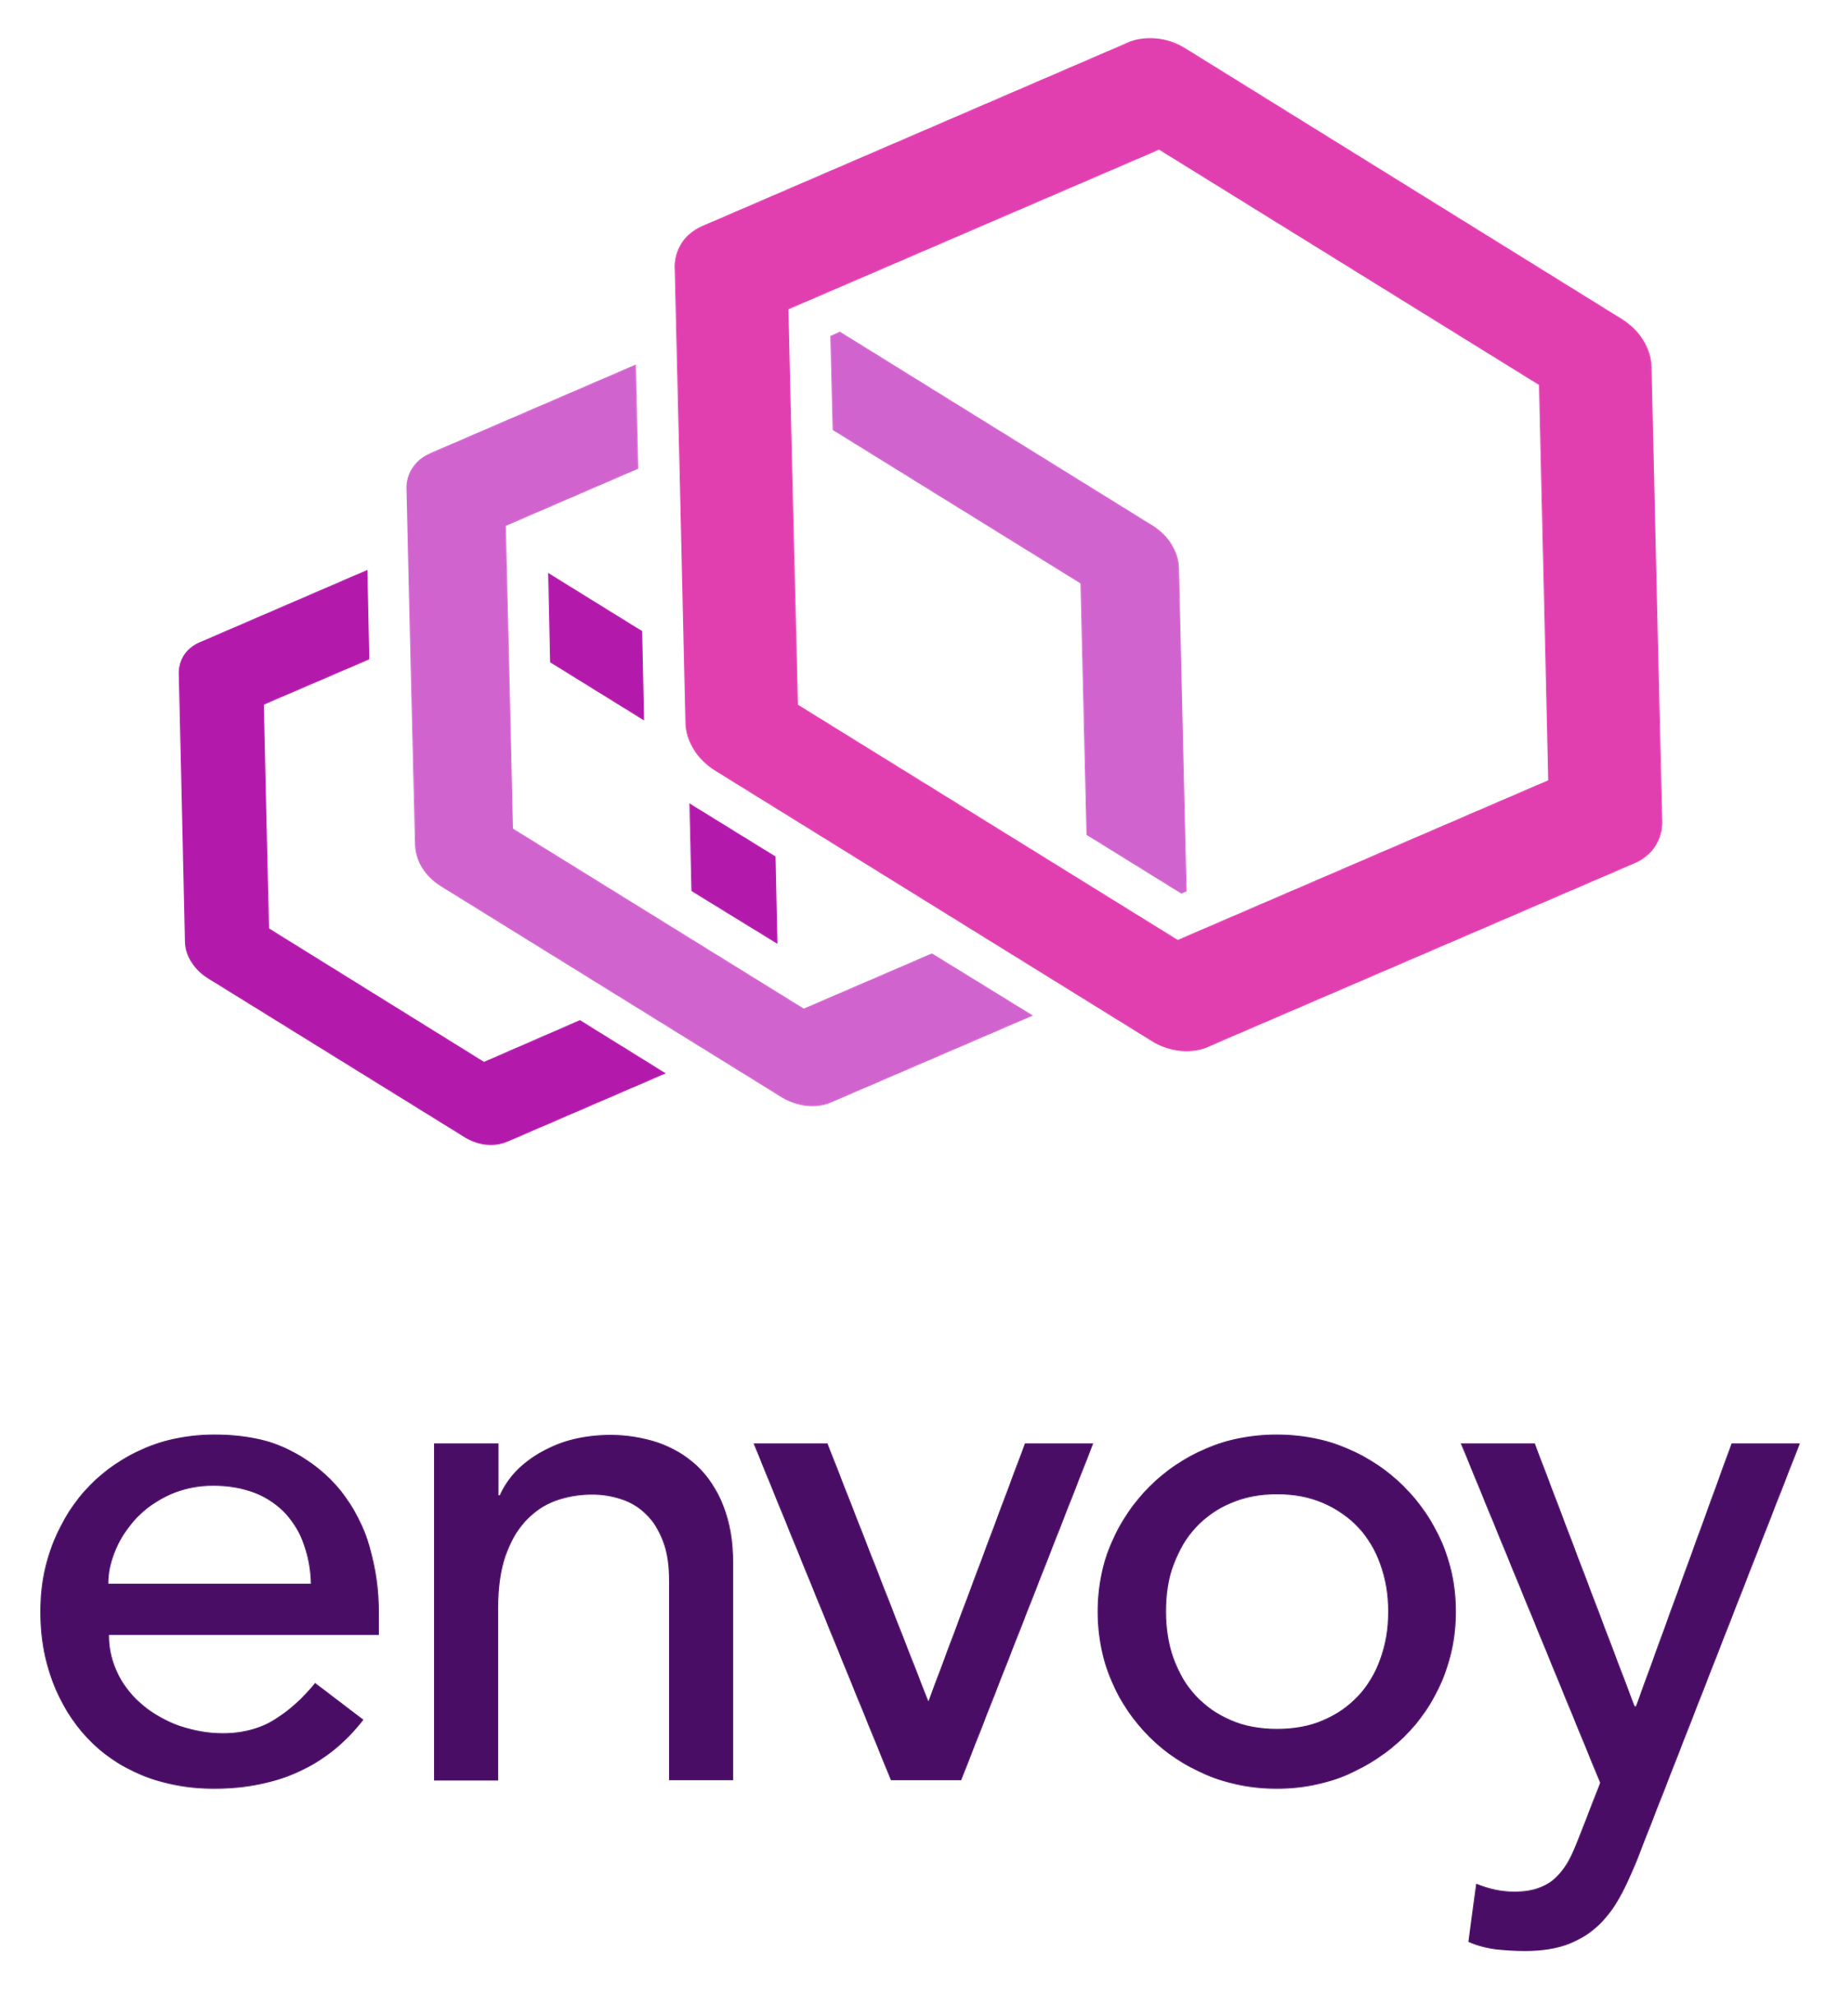


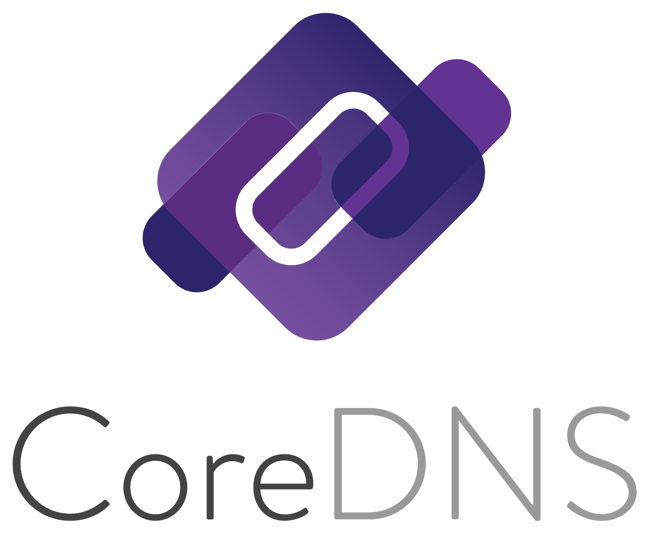


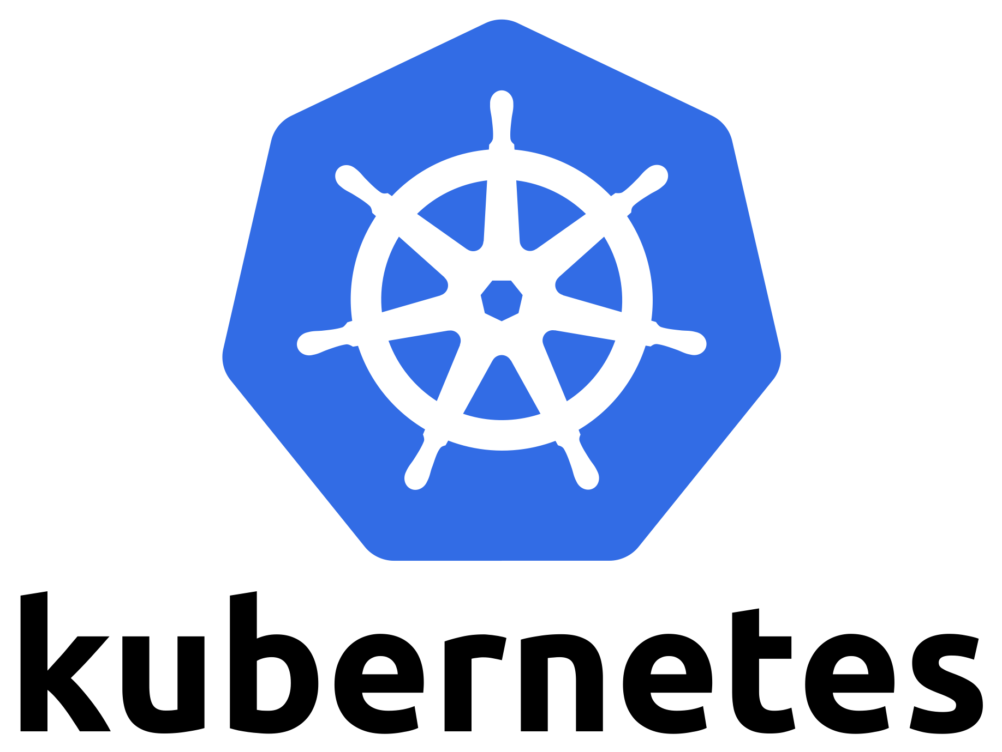
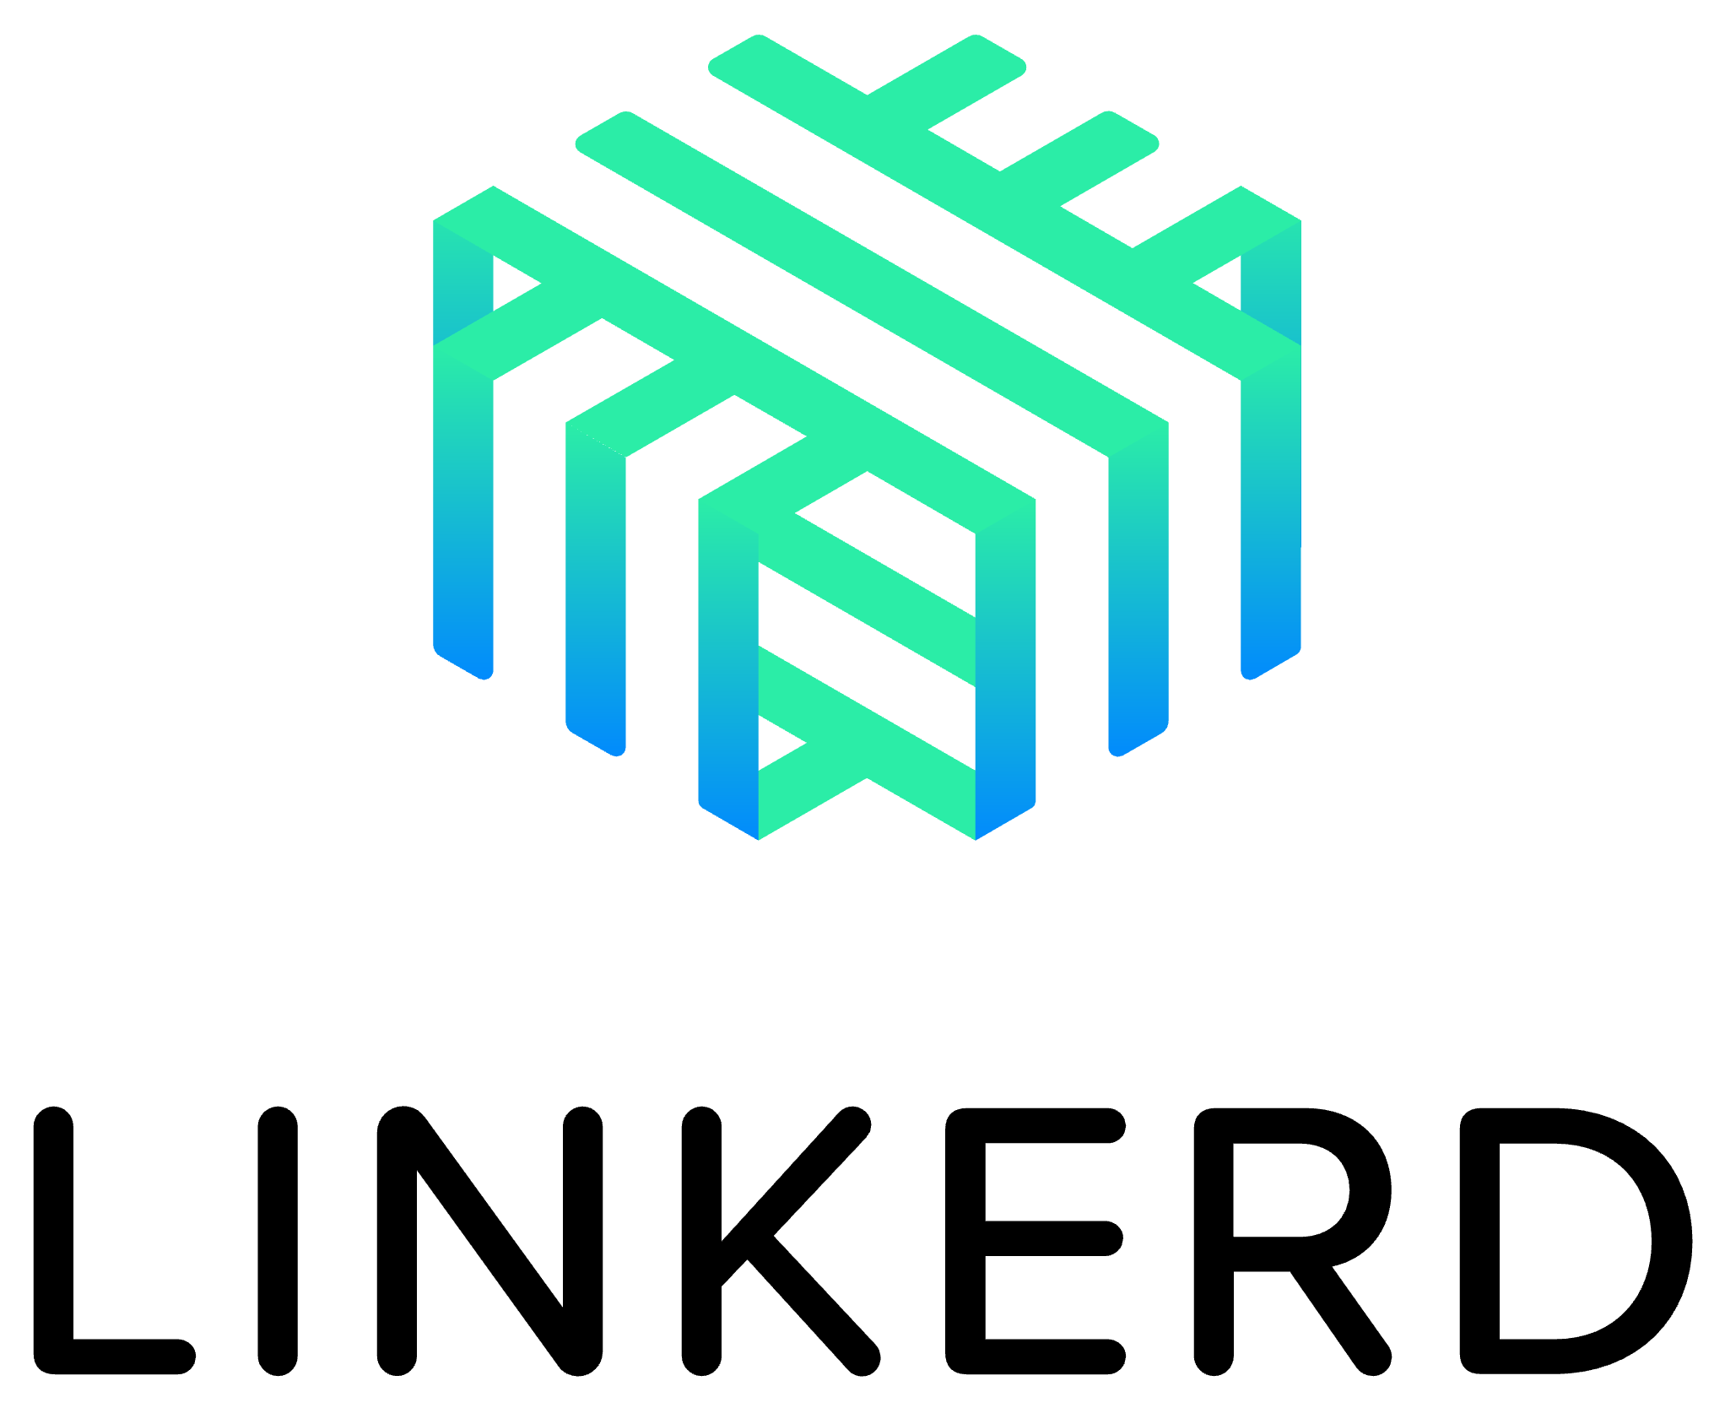













CNCF Graduated Projects
Notes:
24 Graduated Projects

Slide 17
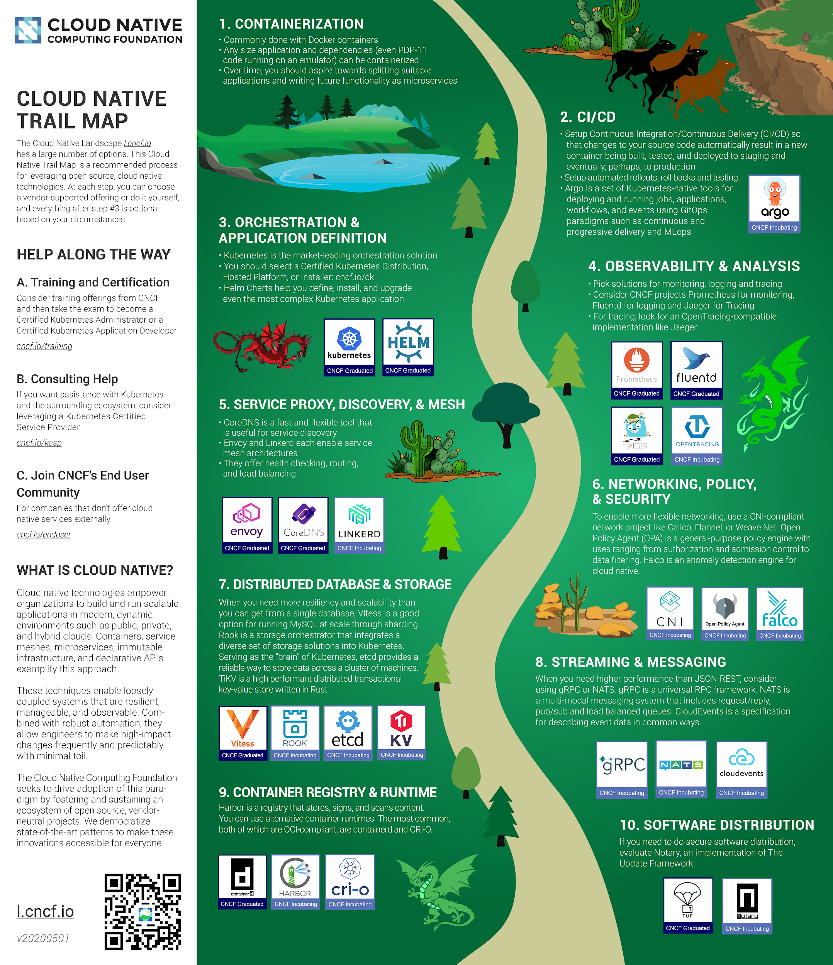
Cloud Native Trail Map
https://github.com/cncf/trailmap

Slide 18
Cloud Native Trail Map
https://github.com/cncf/trailmap

Slide 19
Containerization
https://github.com/cncf/trailmap

Slide 20
Containerization
https://github.com/cncf/trailmap

Slide 21


Open Container Initiative
Container Image Spec
Container Image Distribution Spec
Container Runtime Spec
🙏
Docker donated its container format, runtime, and runC, to the OCI
Notes:
Open Container Initiative (OCI)
2015
The Runtime Specification outlines how to run a “filesystem bundle” that is unpacked on disk. At a high-level an OCI implementation would download an OCI Image then unpack that image into an OCI Runtime filesystem bundle. At this point the OCI Runtime Bundle would be run by an OCI Runtime.
the OCI Image Format contains sufficient information to launch the application on the target platform (e.g. command, arguments, environment variables, etc). This specification defines how to create an OCI Image, which will generally be done by a build system, and output an image manifest, a filesystem (layer) serialization, and an image configuration.
runC runs containers https://github.com/opencontainers/runc

Slide 22


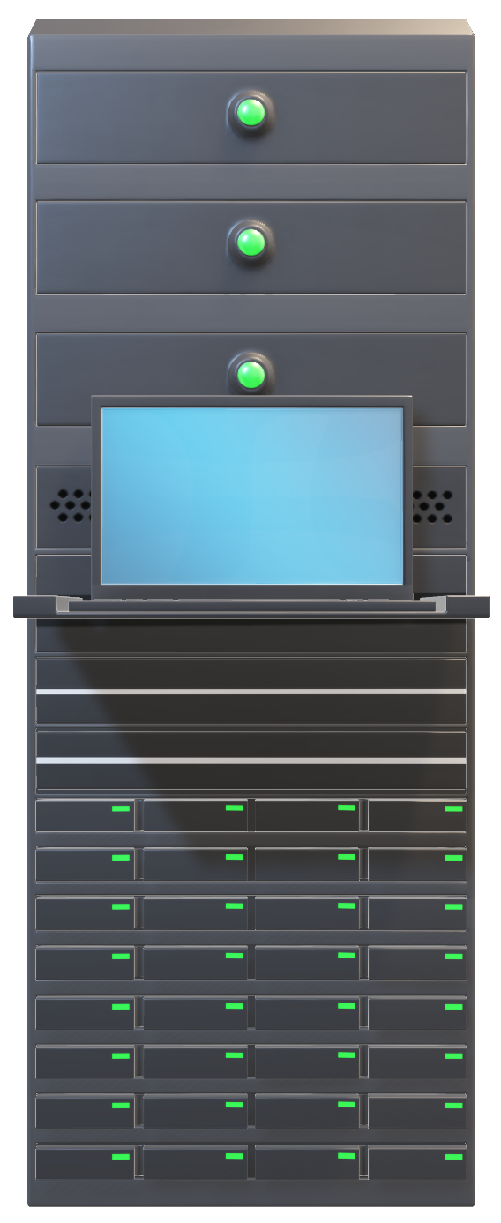
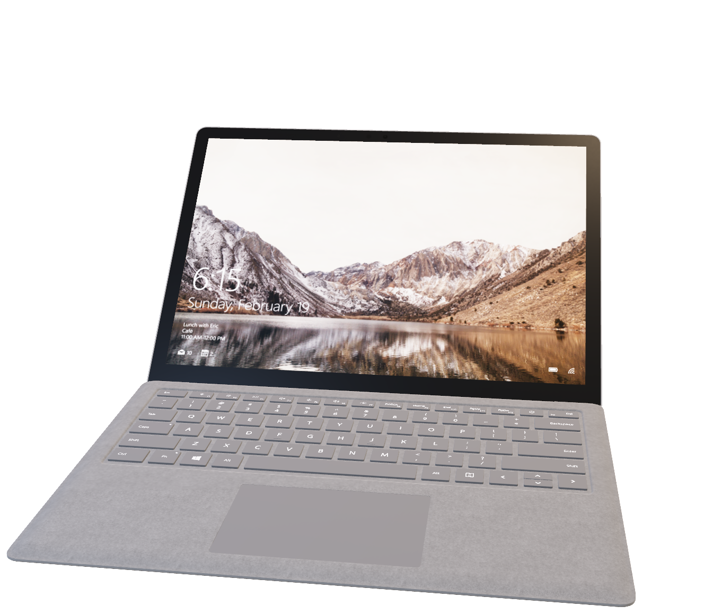
Containerization
It works on my machine!
Notes:
A container is a software solution that wraps your software process or microservice to make it executable in all computing environments.
Containers create a virtualization environment that allows us to run multiple applications or operating systems without interrupting each other

Slide 23
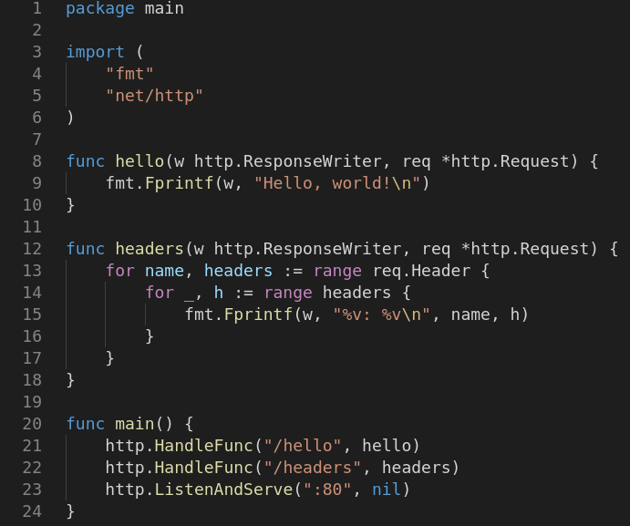

Containerization
Base
Notes:
Containerization is the process of bundling an application and its dependencies into a container image.
Container Image
A config file and layer tarballs

Slide 24
Cloud Native Trail Map
https://github.com/cncf/trailmap

Slide 25
Cloud Native Trail Map
https://github.com/cncf/trailmap

Slide 26
Cloud Native Trail Map
https://github.com/cncf/trailmap

Slide 27
Cloud Native Trail Map
https://github.com/cncf/trailmap

Slide 28

Container Runtime
runc
r/w
Container runtime runs executes containers
based on container images
Base
Base
Notes:
containerd is a container runtime which can manage a complete container lifecycle - from image transfer/storage to container execution, supervision and networking.
runc is lightweight universal run time container, which abides by the OCI specification. runc is used by containerd for spawning and running containers according to OCI spec. It is also the repackaging of libcontainer.

Slide 29


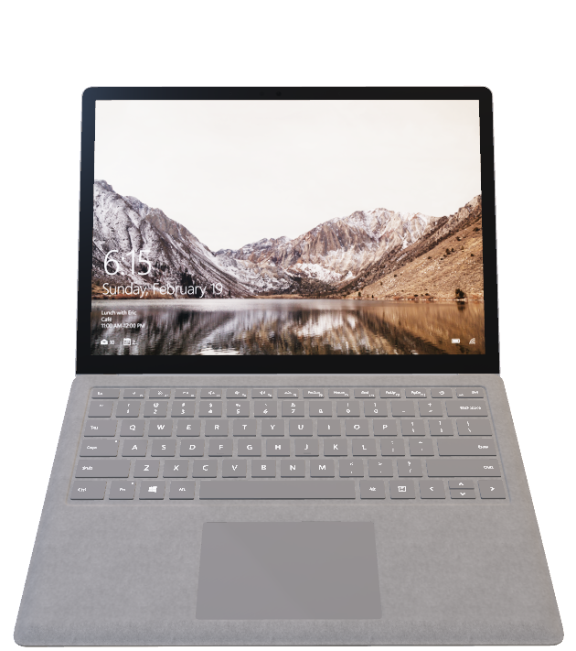
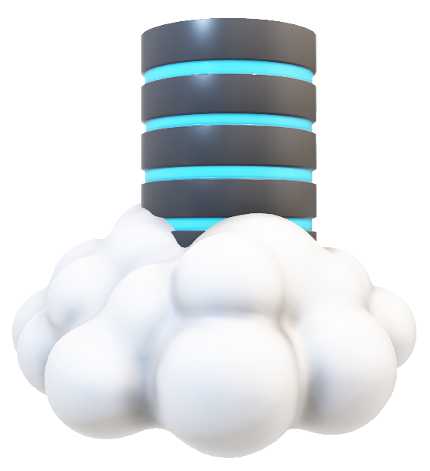
Container Registry
Container Image Registry
docker build
build
push
pull
Store and access container images
Notes:
Harbor is an open source registry that secures artifacts with policies and role-based access control, ensures images are scanned and free from vulnerabilities, and signs images as trusted. Harbor, a CNCF Graduated project, delivers compliance, performance, and interoperability to help you consistently and securely manage artifacts across cloud native compute platforms like Kubernetes and Docker.

Slide 30
Cloud Native Trail Map
https://github.com/cncf/trailmap

Slide 31
Cloud Native Trail Map
https://github.com/cncf/trailmap

Slide 32
Cloud Native Trail Map
https://github.com/cncf/trailmap

Slide 33
Cloud Native Trail Map
https://github.com/cncf/trailmap

Slide 34
Cloud Native Trail Map
https://github.com/cncf/trailmap

Slide 35

Container Orchestration

Slide 36
Container Orchestration

Slide 37
Container Orchestration
Deploy and Manage Containerized Applications on Distributed Compute At-Scale
Container Scheduling
Container Networking
Declarative Configuration
Self Healing
Service Discovery & Load Balancing
Horizontal Scaling
Automated Rollouts and Rollbacks
Storage Orchestration
Configuration Management

Slide 38
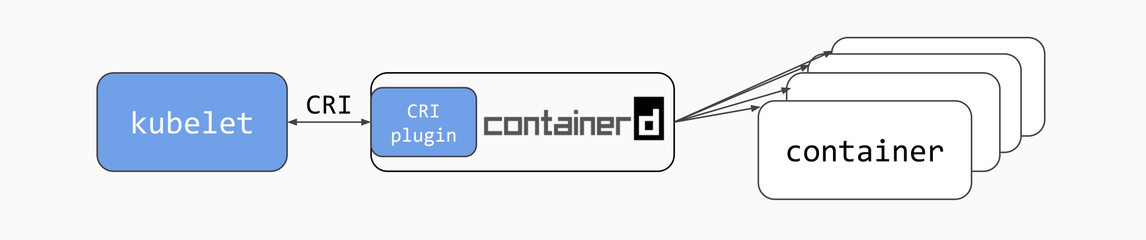
Container Orchestration

Slide 39
Cloud Native Trail Map
https://github.com/cncf/trailmap

Slide 40
Cloud Native Trail Map
https://github.com/cncf/trailmap

Slide 41
Cloud Native Trail Map
https://github.com/cncf/trailmap

Slide 42
Cloud Native Trail Map
https://github.com/cncf/trailmap

Slide 43
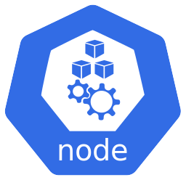

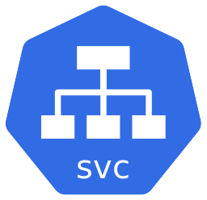
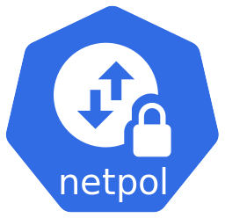
Networking
Notes:
What do network plugins do?
Create the network namespace for the pod (container)
Create interfaces
Create veth pairs
Set namespace networking
Set static routes
Configure Ethernet bridge
Assign IP addresses
Create NAT rules

Slide 44
Networking
Enables networking in Kubernetes with advanced security and observability
Notes:
What do network plugins do?
Create the network namespace for the pod (container)
Create interfaces
Create veth pairs
Set namespace networking
Set static routes
Configure Ethernet bridge
Assign IP addresses
Create NAT rules

Slide 45
Cloud Native Trail Map
https://github.com/cncf/trailmap

Slide 46
Cloud Native Trail Map
https://github.com/cncf/trailmap

Slide 47
Cloud Native Trail Map
https://github.com/cncf/trailmap

Slide 48
Cloud Native Trail Map
https://github.com/cncf/trailmap

Slide 49


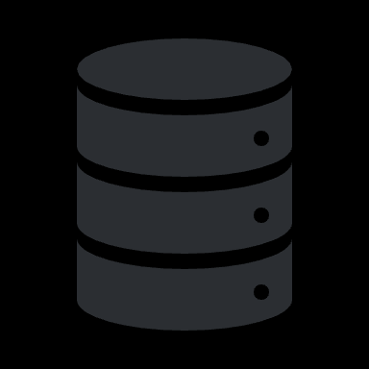

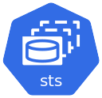






Application Definition
Application
Notes:
Helm automates the creation, packaging, configuration, and deployment of Kubernetes applications by combining your configuration files into resusable packages called charts.

Slide 50
Application Definition
Chart
Application
Notes:
Helm automates the creation, packaging, configuration, and deployment of Kubernetes applications by combining your configuration files into resusable packages called charts.

Slide 51
Cloud Native Trail Map
https://github.com/cncf/trailmap

Slide 52
Cloud Native Trail Map
https://github.com/cncf/trailmap

Slide 53
Cloud Native Trail Map
https://github.com/cncf/trailmap

Slide 54
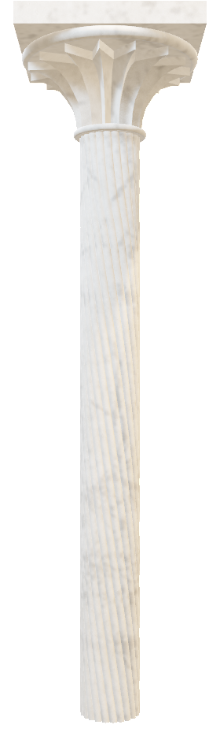
Observability and Analysis
bservability

Slide 55
Observability and Analysis
bservability
Metrics
Logs
Traces

Slide 56
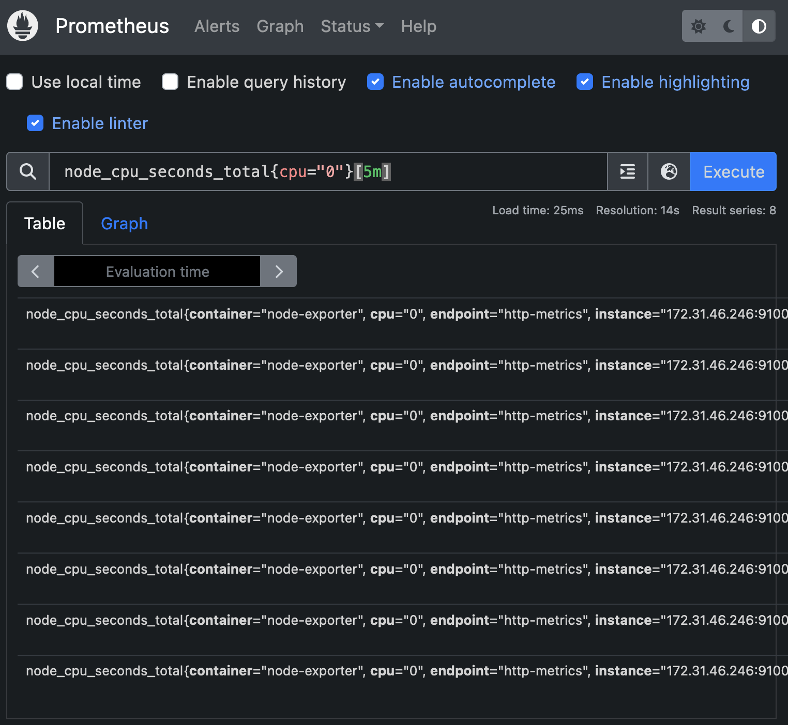
Observability and Analysis - Metrics
Monitoring toolkit that collects and stores metrics as time series data

Slide 57
Observability and Analysis - Logs
stdout
stderr
$ kubectl logs -n my-namespace nginx-789bf7b8fc-95b45
/docker-entrypoint.sh: /docker-entrypoint.d/ is not empty, will attempt to perform configuration
/docker-entrypoint.sh: Looking for shell scripts in /docker-entrypoint.d/
/docker-entrypoint.sh: Launching /docker-entrypoint.d/10-listen-on-ipv6-by-default.sh
10-listen-on-ipv6-by-default.sh: info: Getting the checksum of /etc/nginx/conf.d/default.conf
2023/11/02 05:31:57 [notice] 1#1: start worker process 31

Slide 58

Observability and Analysis - Logs
stdout
stderr

Slide 59
Observability and Analysis - Logs
stdout
$ kubectl logs -n my-namespace -l app=nginx
2023/11/02 06:35:40 [error] 29#29: *1 open() "/usr/share/nginx/html/favicon.ico" failed (2: No such file or directory), client: 10.0.0.65, server: localhost, request: "GET /favicon.ico HTTP/1.1", host: "kubernetes.34.222.160.192.sslip.io:30000", referrer: "http://kubernetes.34.222.160.192.sslip.io:30000/"
10.0.0.65 - - [02/Nov/2023:15:52:32 +0000] "\x16\x03\x01\x00\x85\x01\x00\x00\x81\x03\x03+Y\xFD\x07Q\x1E\xDC\x9D~\x04q7\xF73\xFB\xED\xBAN\xEB\xED\xFF\x04\xC8i]\xF2@\xBB\xA2\x14\xA09\x00\x00 \xC0/\xC00\xC0+\xC0,\xCC\xA8\xCC\xA9\xC0\x13\xC0\x09\xC0\x14\xC0" 400 157 "-" "-" "-

Slide 60
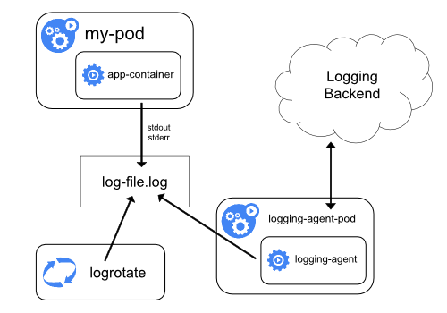
Observability and Analysis - Logs
Unified data / log collector

Slide 61
Cloud Native Trail Map
https://github.com/cncf/trailmap

Slide 62
Cloud Native Trail Map
https://github.com/cncf/trailmap

Slide 63
Cloud Native Trail Map
https://github.com/cncf/trailmap

Slide 64
Cloud Native Trail Map
https://github.com/cncf/trailmap

Slide 65
Cloud Native Trail Map
https://github.com/cncf/trailmap

Slide 66
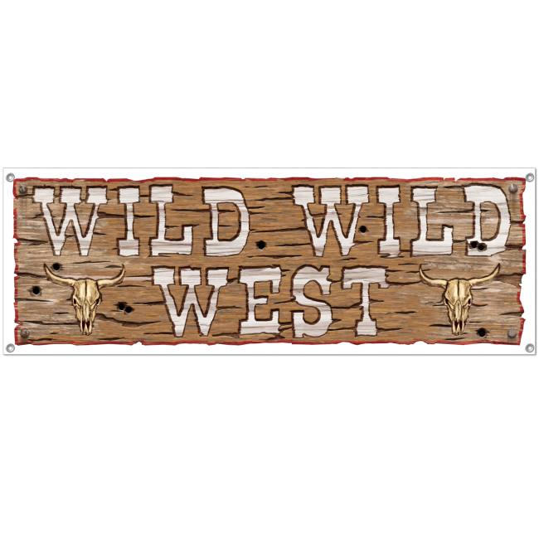
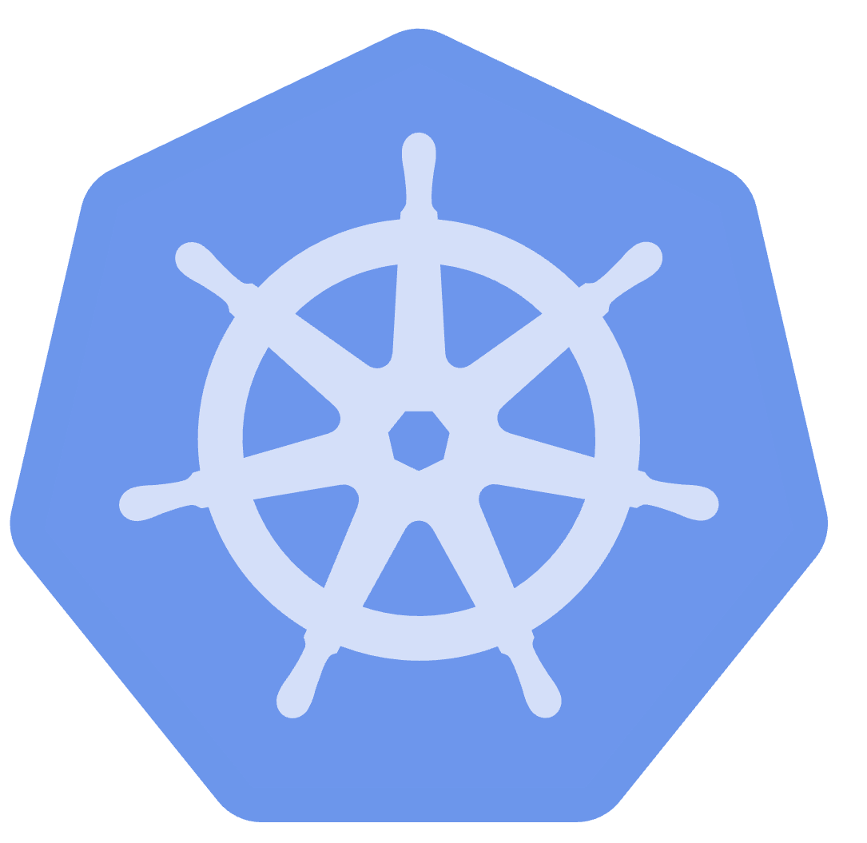
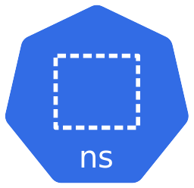
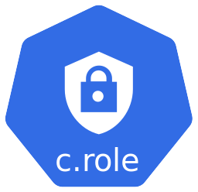

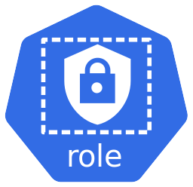
Policy
*
*
namespace = default
privilege = true
no labels

Slide 67
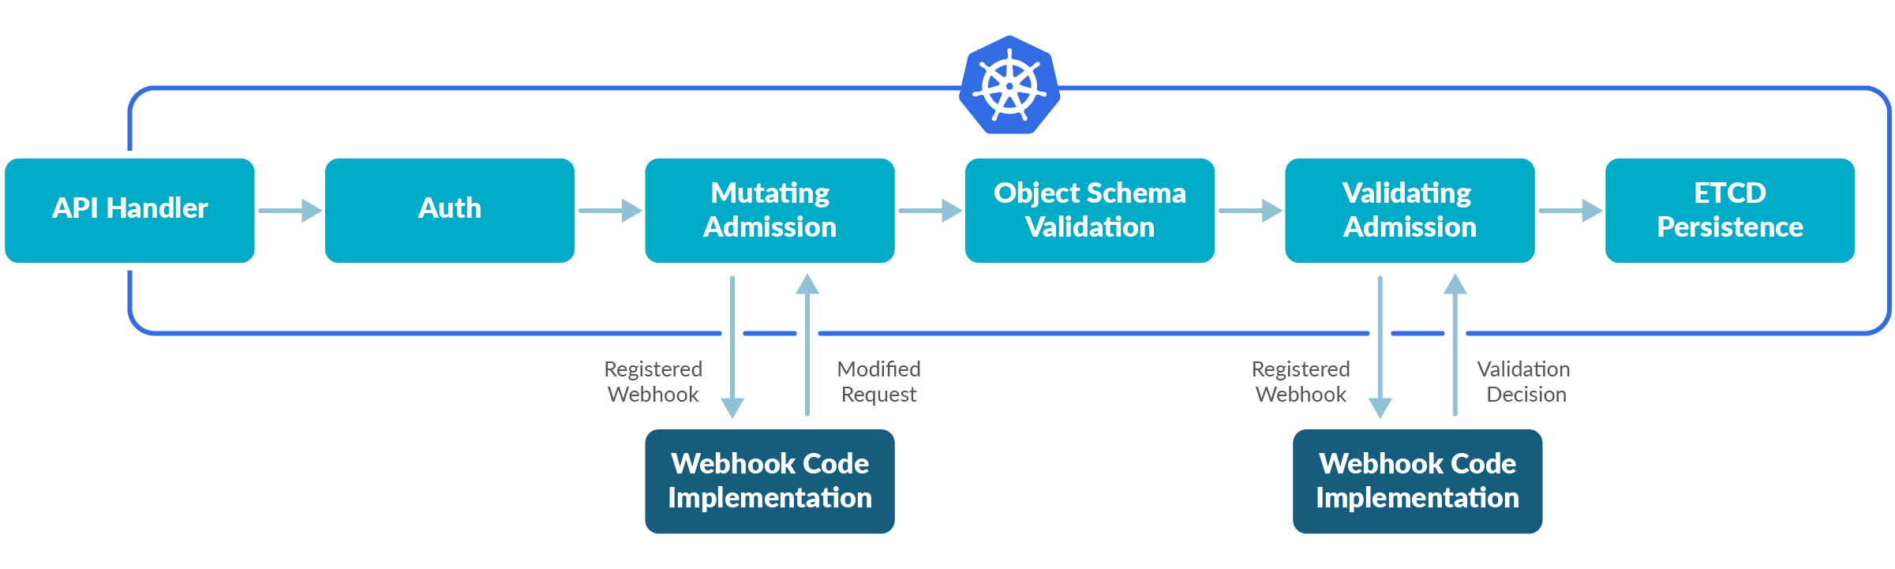
Policy – Admission Control
Admission Controllers intercept and process requests to the Kubernetes API before the object is created. They can validate or mutate.
Policy engine that unifies policy enforcement
Notes:
An admission controller intercepts and processes requests to the Kubernetes API prior to persistence of the object, but after the request is authenticated and authorized

Slide 68
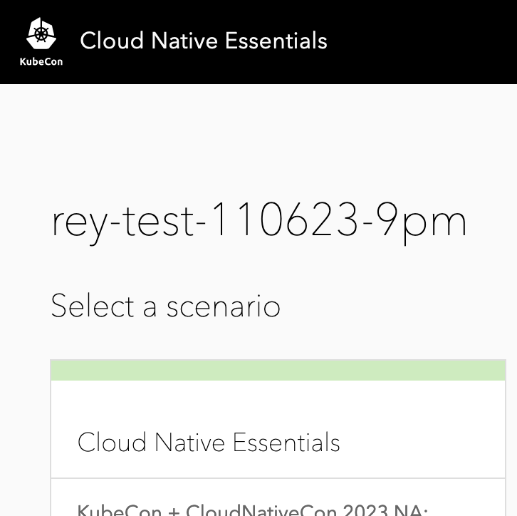
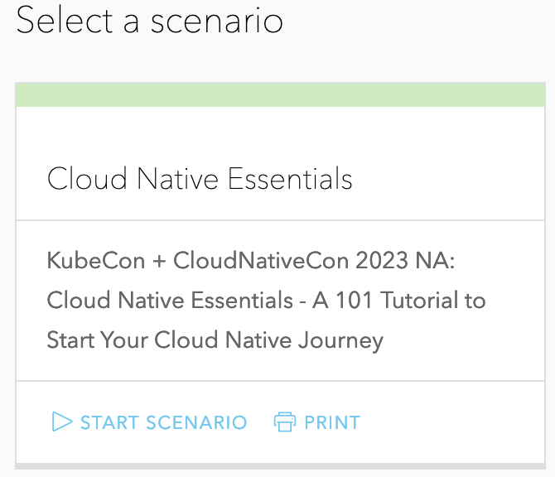
Hands-On with Hobbyfarm
Navigate to https://lab.cloudnativeessentials.com
Register with your email and password
Access Code: kubecon23
A browser refresh may be required
If no scenario shows, check the access code
YouTube playlist of lab: https://www.youtube.com/playlist?list=PLRZy2nta6-RvBtzgOenFU5Tdp3qmmLaqh
Slides and Lab are available https://github.com/cloudnativeessentials/kubecon2023

Slide 69

Please scan the QR Code above
to leave feedback on this session

